Slide 1

EU ETS Price of Permits
Valentina Bosetti
Bocconi University
RFF-CMCC European Institute on Economics and the Environment
TERNA (Italian TSO)

Slide 2
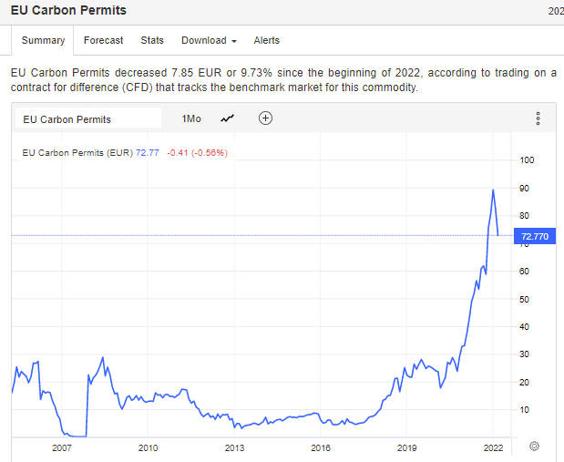
long run

Slide 3
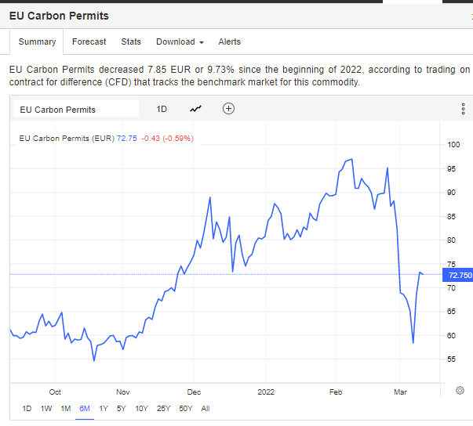
last 6 months

Slide 4
Overview
In 2021, the European price of carbon marked a sharp increase, albeit far below the increase in gas prices.
The increase is due to the increased demand for emission allowances due to
acceleration of activity economic after COVID-19
expectations related to climate goals for 2030
high gas prices, as they induce to use more coal for energy purposes
And market factors:
market stability reserve only controls quantity
Increased share of auctioned allowances
The Emissions Trading System (ETS) provides safeguards in case of excessive price fluctuations, but conditions so far have not activated them.
From the end of February 2022, the European price of carbon plummeted to EUR 55 and bounced back at 70 per ton. Prices for CO2 permits have also plunged in North America, the United Kingdom and Australia despite record-high levels for natural gas and coal and an oil surge.

Slide 5
eu ets market factors

Slide 6
expectations on the CAP
The Fit for 55 plan makes cap more stringent, 55% compared to 1990
In 2050 climate neutrality
Proposal to include shipping emissions in EU ETS
Creating a market for other sectors (e.g. transport)

Slide 7
auctioned allowances
In total, the Commission estimated that 57% of the total amount of general allowances were auctioned in phase 3.
In phase 4 (2021-2030), the share of allowances to be auctioned remains the same.
Progressive Phase out free allowances for aviation (completed in 2027)

Slide 8
the market stability reserve
Established in 2015, in operation from 2019, the market stability reserve (MSR) was introduced as a means to align the supply of emissions allowances more closely with demand, and enhance the resilience of the ETS.
The MSR operates entirely on the basis of pre-defined rules without any possibility for intervention by the Commission or Member States, in order to maintain regulatory stability and ensure long-term predictability.
Rule-based mechanism to reduce/increase total number of allowances in circulation, by absorbing/releasing parts of the auction volumes. The surplus of allowances determines the response of the stability reserve:
If surplus > threshold A, a predetermined percentage of the surplus is withheld from auctions and added to the reserve;
if surplus < threshold B, some allowances are taken from the reserve and injected into the market through auction.
Triggers: minimum and maximum total number of allowances in circulation; actions: intake rate; minimum number of allowances in the reserve.
Amendment proposed to maintain the current doubled intake rate (24 %) and minimum number of allowances placed in the reserve (200 million) until 31 December 2030, the end of Phase IV of the EU ETS.
From 1 January 2031 onwards the intake rate would fall to 12 % and the minimum number of allowances to 100 million.
The Commission notes that the proposal affects Member States' budgets by reducing auction volumes.

Slide 9
energy markets

Slide 10
the energy demand driver
Natural gas represents around a quarter of the total energy consumption in the Union.
~ 26% used in the energy production sector (also in power plants in cogeneration of thermal and electrical energy) and ~ 23% in the industrial sector.
Remainder is divided mostly between households and the tertiary sector, mainly for the purposes of heating and cooling.
Although there has been a transition in recent years towards gas and renewables, with nuclear stable at around 25% of the electricity mix, in some Member States, rising gas prices prompted at least a return temporarily to coal, despite its higher CO2 intensity per MWh.
The EU's dependency rate on energy imports stood at 61% in 2019 (56% in 2000).

Slide 11
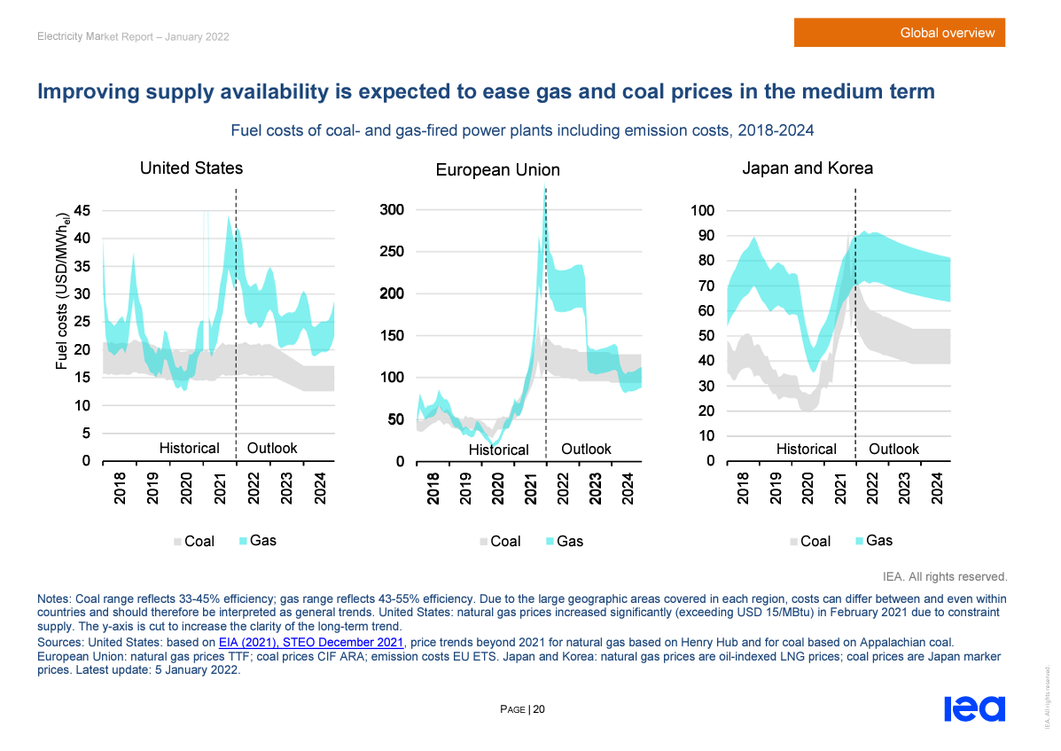
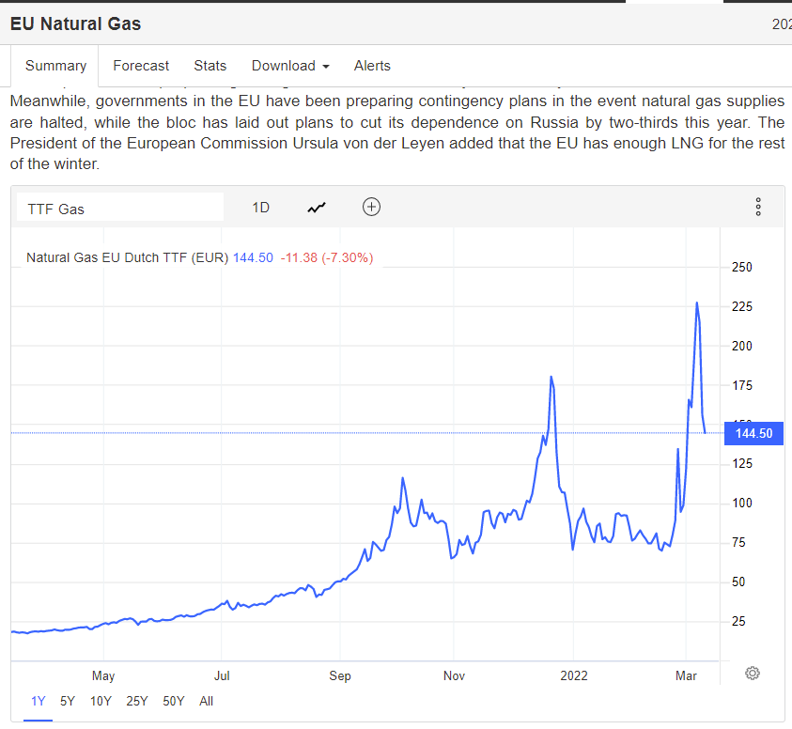

Slide 12
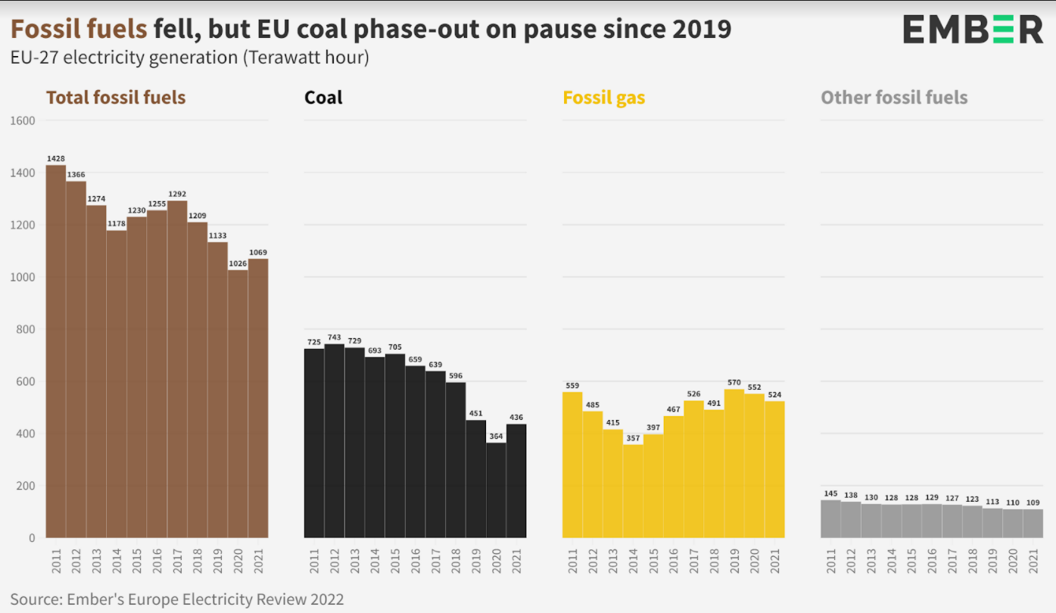
Coal power

Slide 13
the war
While before war prices of EU ETS permits grew in line with fossil fuels as the energy crisis unfolded, now the trend reversed.
Selloff of CO2 permits may be caused by a lack of cash due to losses from energy and other commodities high prices.

Slide 14
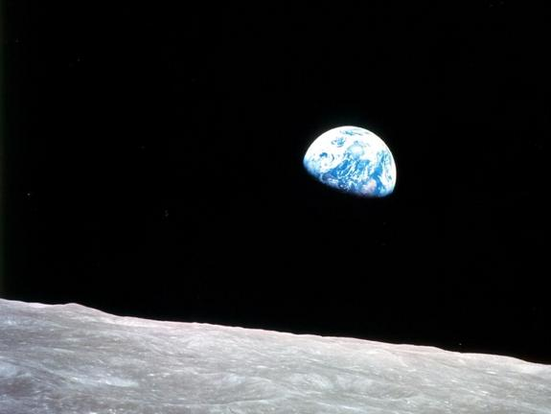
Valentina.bosetti@unibocconi.it
Thank you!

